Slide 1
Cash Machine Solution
Robert Wąsik

Slide 2
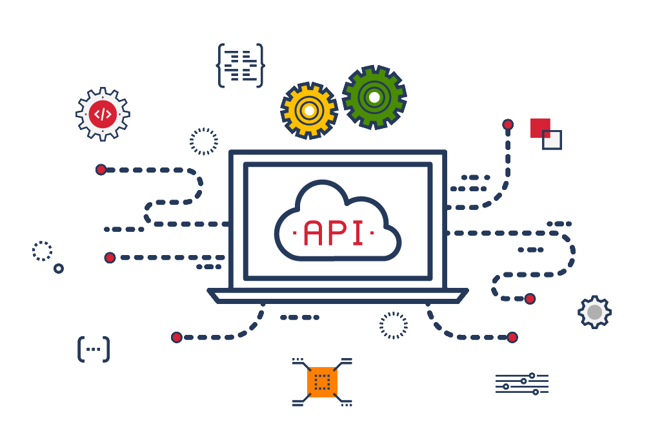

Execution plan
Create API
(cash machine business logic)
Create WebApp
(user interface & will make usage of API)

Slide 3




API - goals
Create clean, maintainable,
easy to understand code
Test code well
Create code which follows SOLID principles
Make code open for extensions
(e.g. new 200 notes)

Slide 4

API – tech stack
.NET Core 2.2

Slide 5

API – tech stack
.NET Core 2.2
Microsoft Test Framework

Slide 6
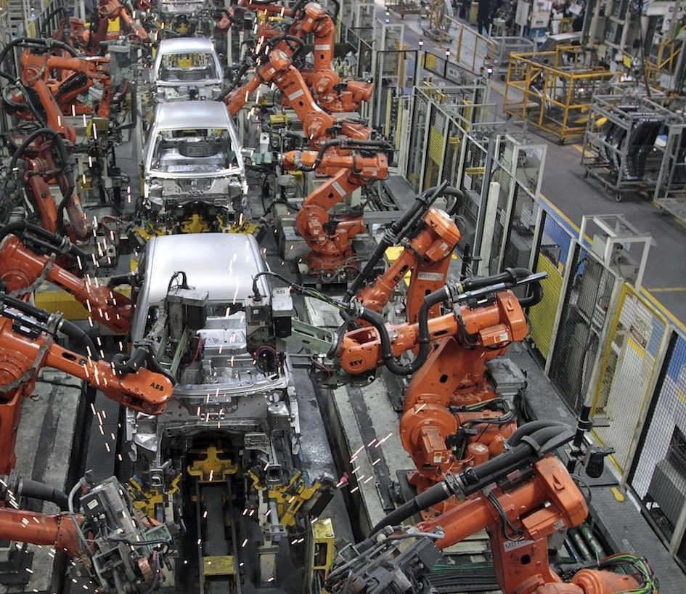
API notes calculation approach:
The Pipeline Pattern

Slide 7
The Pipeline Pattern
Each note = separate link
Separate link for amount validation is defined
Notes quantity calculation is made inside each link
Amount is modified and passed to the next link
Input
Pipe Link
…
Pipe Link
Output
Input for pipe (before execution)
In our case amount to withrdaw
Output defines notes quantity

Slide 8

API - accomplishments
Clean, maintainable,
easy to understand code
Well tested code
Code which follows SOLID principles
Open for extensions

Slide 9
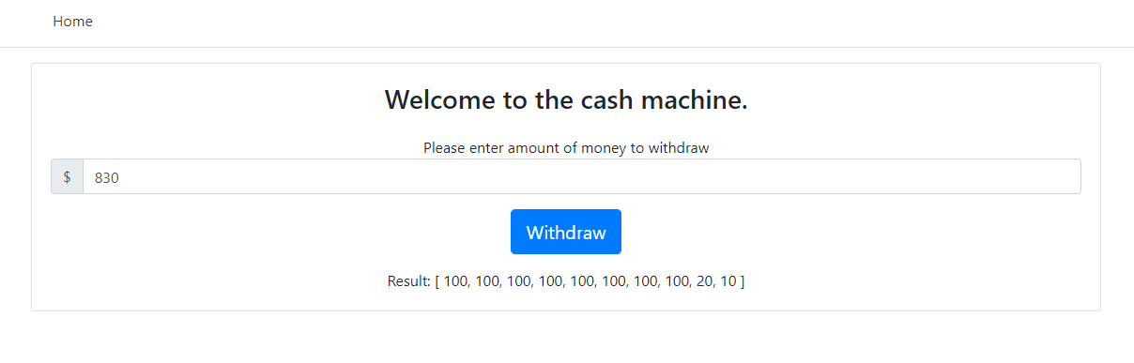
WebApp

Slide 10
WebApp – tech stack
ASP.NET Core Web App (MVC)

Slide 11

WebApp – tech stack
ASP.NET Core Web App (MVC)
jQuery

Slide 12

WebApp – tech stack
ASP.NET Core Web App (MVC)
jQuery
Handlebars

Slide 13

WebApp – tech stack
ASP.NET Core Web App (MVC)
jQuery
Handlebars
Twitter Bootstrap

Slide 14
Thank you!

